Slide 1

Sales Performance Deep Dive and Forecast: A ML Driven Analytics Solution
Team: Dijkastra
Pranov Shobhan Mishra (VP – Risk Intelligenece at JPMorgan)
Manav Tyagi (Solution Architect)
Aniket Chhabra (Data Scientist at Paypal)
Swapneel Gitccha (VP – Data Scientist at CitiBank)
The codes can be found in the GitHub link below
https://github.com/Pranov1984/Sales-performance-Deep-Dive-and-forecast----An-UNILEVER-Use-Case

Slide 2
Agenda
Executive Update
Business overview: Problem understanding & Analysis Architecture
Model Deployment Architecture
Modeling Outputs

Slide 3
Executive Summary
Problem Statement
One of Unilever’s brands is going through a steep decline in revenues and is requiring major changes in business execution plans. The management is expecting a thorough analysis of historical performances culminating in identification of key factors driving sales.
Data Summary and Product Life Cycle Overview
The data provided constituted more than 30 years of information of sales and related variables.
The training data suggested that the product has gone through a life-cycle of launch, growth and maturity. There were indications of a decline phase in the last few periods of training data.
The test data corroborated the indications as we could notice sharp decline (more than 25%) since 2016.
Key Insights & Driver Analysis
The factors having a significant positive impact on sales volumes were identified to be promotion expenditure, volumes produced or in stock, inflation, rainfall and visibility through social search impressions.
The factors having a significant negative impact on sales volumes were identified to be brand equity, competitor prices, fuel price and digital impressions
Forecasting
Multiple approaches were attempted including ARIMA, Holt Winter’s Double Exponential Smoothing, Bayesian approach(BSTS) and LSTM
The best results were achieved when training data was combined with 2 years of test data to capture the decline phases. MAPE of 25% achieved with Holt Winter followed by ARIMA with a mape of 33%.
For the second problem statement that required training on test data only, best results were achieved through the bsts model followed by LSTM. Mapes of 5% and 13% respectively were achieved.

Slide 4






Business overview: Problem understanding & Requirement Gathering
Build a process to estimate the sales forecast due to change in brand’s business execution strategy
Deep dive to the root cause of the factors contributing to brand sales
Leverage data, develop ML algorithm, provide sales intelligence using forecasting analysis to enable sales team to do their job easier
Background and Objective
Analysis Architecture
Data Elements
Data Deep Dive
Sales
Forecast
Deployment
Removing Inconsistencies
Univariate Analysis
Multivariate Analysis
Transformations
Collect
Marketing and Sales data and add dimensions
Exploratory Data Analysis
Build Model Ready Data
Build an ML algorithm to estimate sales forecast
Build framework to deploy model using technical stacks

Slide 5
Why do we exist: An elevator Pitch
Our mission is to help unilever:
make distinctive and substantial improvements in business using data Science and Machine Learning
Tie data to business decisions that drive long term strategy as well as Business growth

Slide 6
Model Deployment Architecture: An Automated Solution
Input Data Processing
Measurement Methodology & Modeling
Reporting
Pre-Processed
data
Method-1
Bayesian Time Series
Model
Forecast
Data Level
Promotions
Spends
Supply
Trade Promo
Price
Volume
Mkt Budget
Revenue
Categories
Engagement
Reporting Upside Estimates
Customer KPI
Marketing KPIs
Model Results - Estimated Upside
(Ensembled)
Sales KPIs
Monthly /
Quarterly Refresh
Financial KPIs
Method-2
ML Algorithm
Measure Pre-Post Growth
Implementation Tools
Python/R
Tableau Dashboard

Slide 7
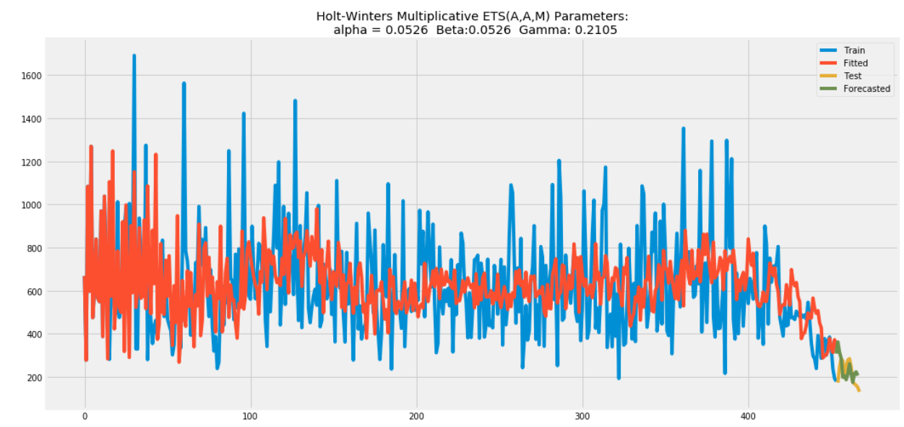
Model Output: on training data (requirement I)

Slide 8
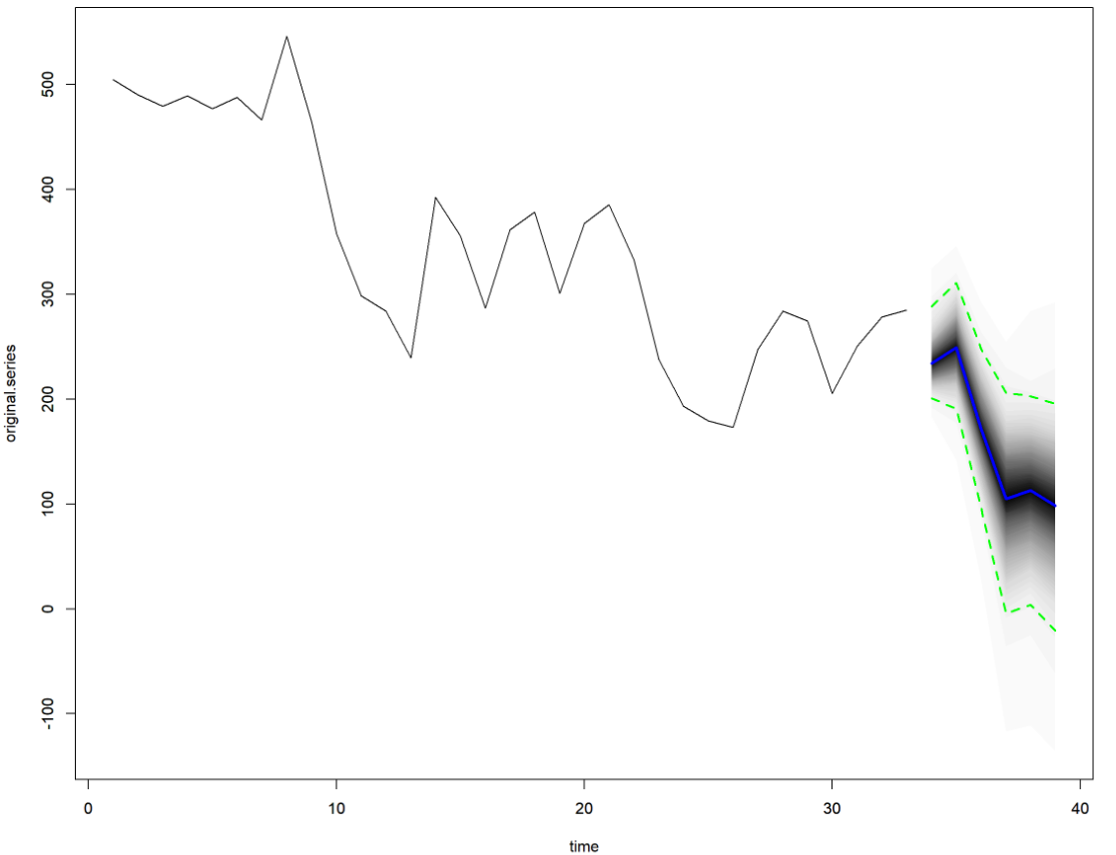
Model Output: on test data (requirement II)

Slide 9
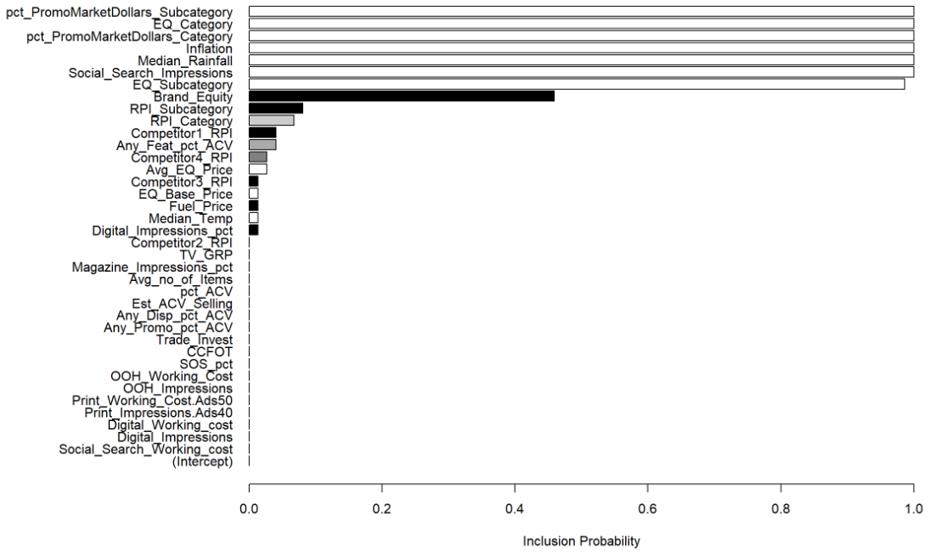
Model Output: Identification of significant variables

